Slide 1

Real Estate Market Analysis

Slide 2
Steps Involved
01
Data Collection - Scraping
Data Analysis
02
Data Cleansing
Data Visualization
03
Data Visualization
Data Cleansing
04
Data Analysis
Data Collection
www.free-powerpoint-templates-design.com

Slide 3

Action
Data collection – Scraping:
Collected the data points available on the Zillow website related to the houses listed like z-estimate, house details etc. using Beautiful soup library.
Data Cleansing:
Involved in cleaning the raw information available from the cleansing activity. Formatted the datatypes, incorrect/missing data etc.
Data Visualization:
Represented the information available graphically and in readable format by using the histograms, charts and plots.
Data Analysis:
Deep dived into the information collected to analyze the important aspects of the housing marked based on the listings.

Slide 4

Data collection - Scraping
Started the collection activity by scrapping the Zillow website for Bay Area.
Collected the features like House type, House size, Street, City, Zip code, Z-estimate, Bedrooms, Bathrooms, year built, Parking info, Lot size, HOA etc.
Used Beautiful soup python library available to collect this information which involves in multiple steps like generating the URLs for the houses available and loop through them to scrape the data.

Slide 5
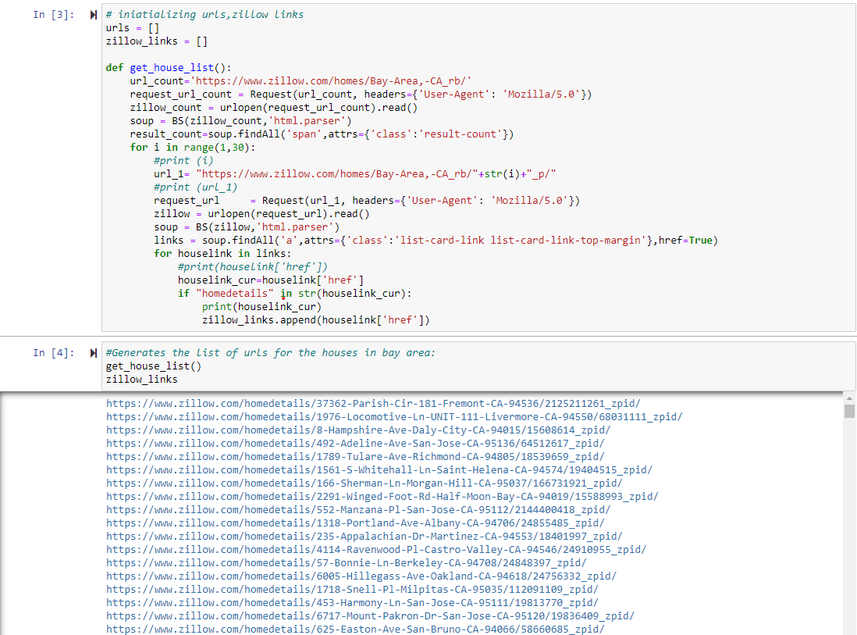

Slide 6
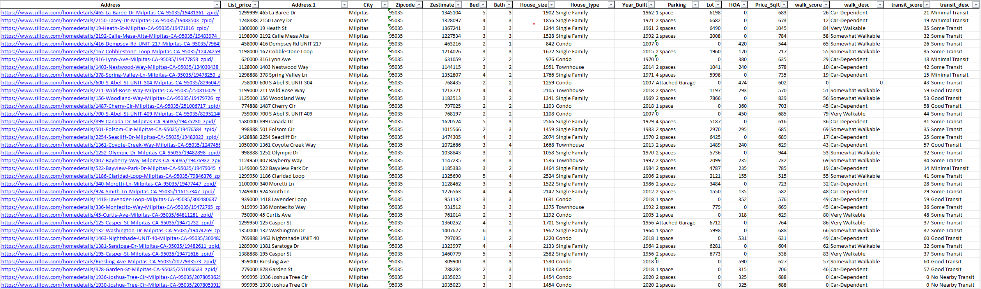
Scrapped Data

Slide 7
Data Cleansing
As Scrapping data is in raw format and might have anomalies, cleansed the data to remove irrelevant characters and all numeric values and missing data elements etc.
Also, along with cleansing involved in data wrangling activity to a certain extent and added few more features to the data like walking description, transit score and transit description.

Slide 8
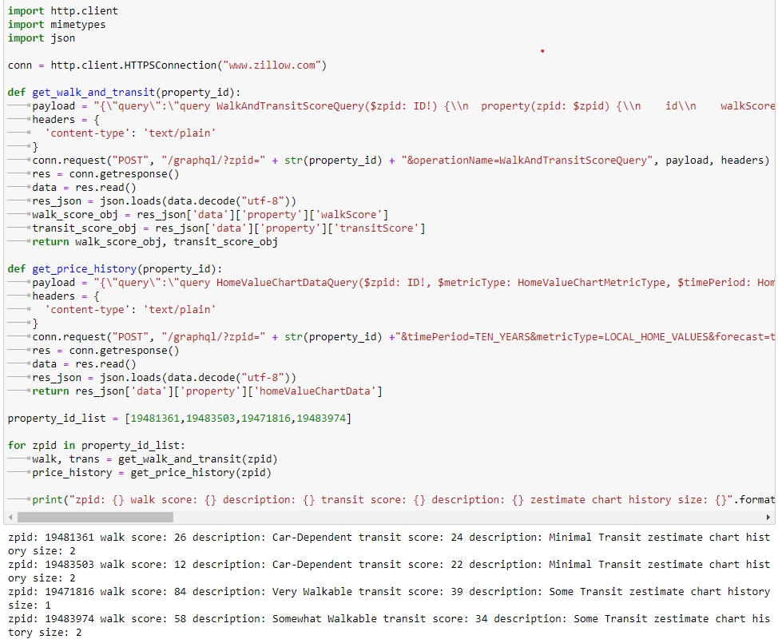
Added Features

Slide 9
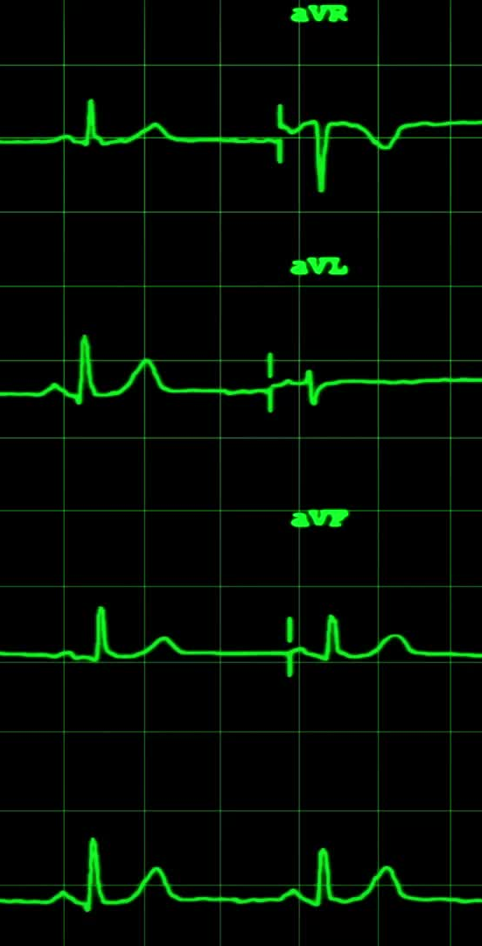
Data Analysis:
Performed multiple analysis using below
Histograms
Scatter plots
Heatmaps
Box plots
Pie charts
Scatter matrix

Slide 10
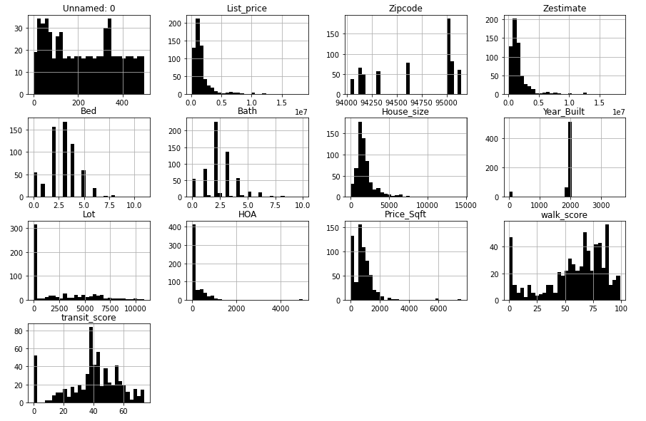
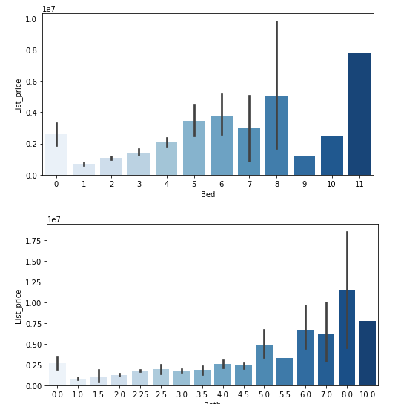
Histograms
Histograms based on price, bath, zip, Zestimate, transit score, walk score etc
Histograms for list price based on bed and bath

Slide 11
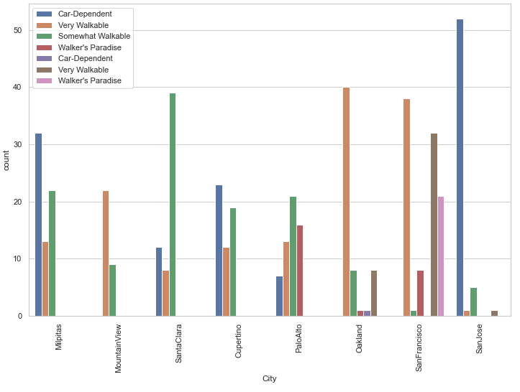
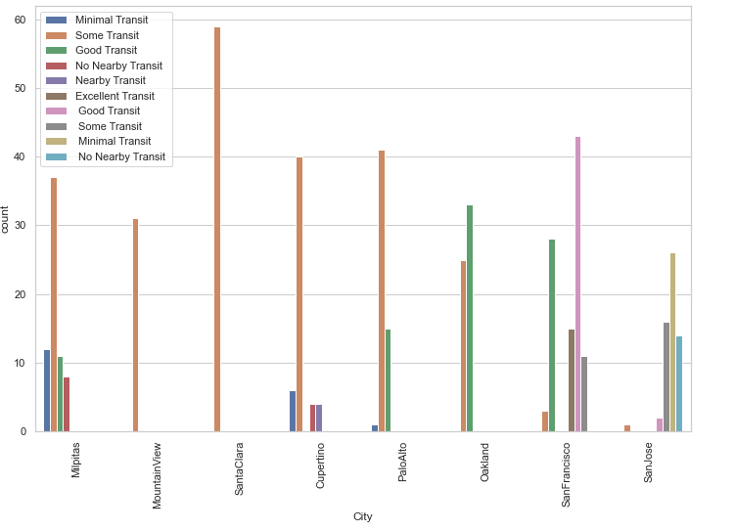
Walk description Histogram
Transit description histogram

Slide 12
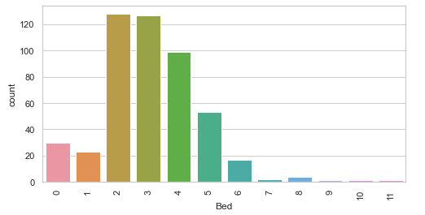
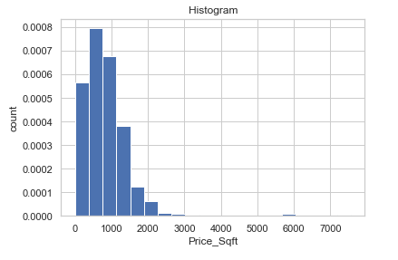
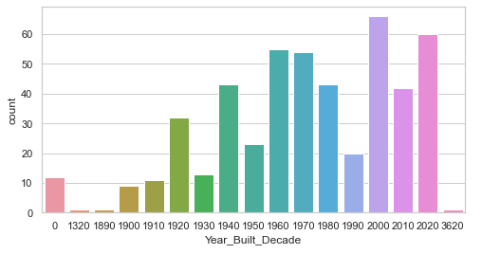
Histogram for house counts based on bedrooms
Histogram for house counts based on price per sqft
Histogram for house counts based on year-built decade

Slide 13
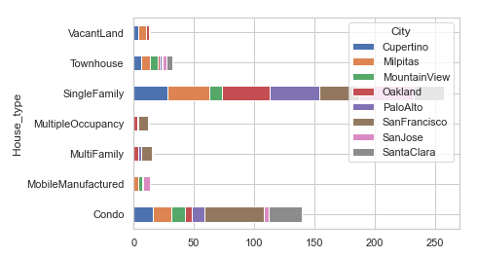
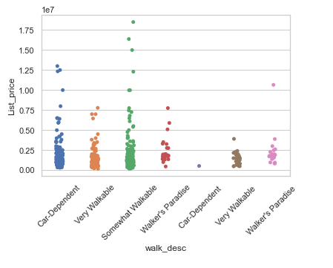
Bar chart & Scatter Plots
Bar chart based on house types
Plot for list price and walk description

Slide 14
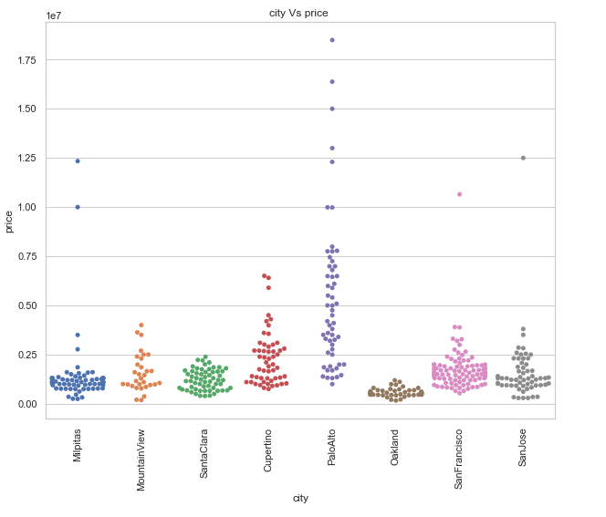
Scatter chart for cities vs price

Slide 15
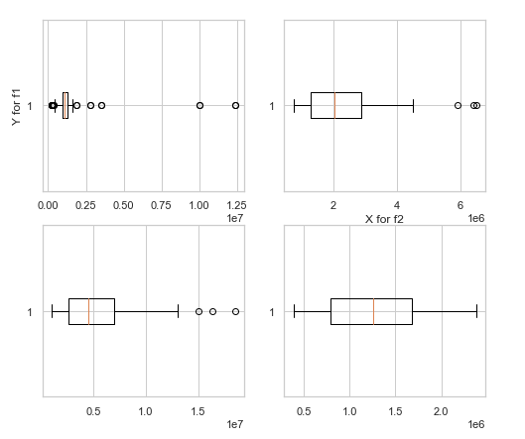
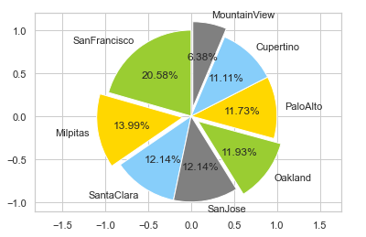
Box Plot & Pie chart
Box plot for list price for different cities
Pie chart for house counts in different cities

Slide 16
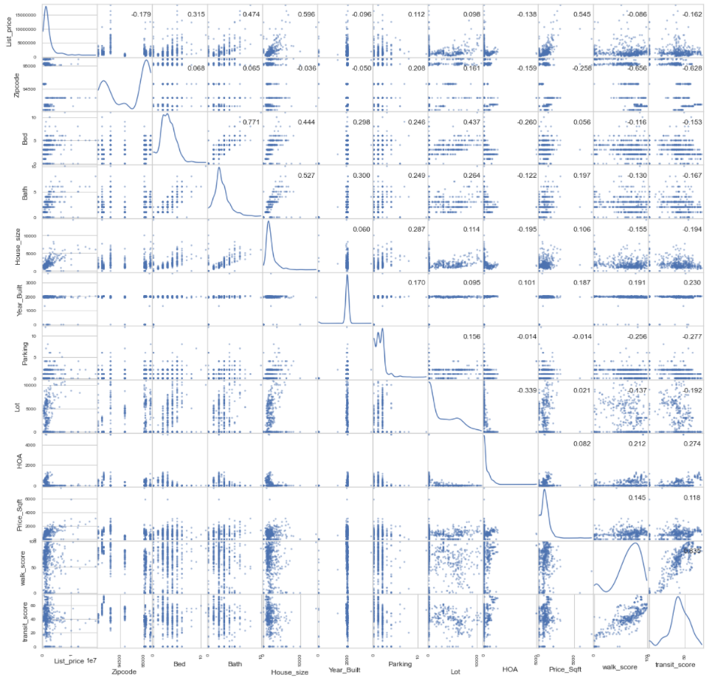
Scatter matrix

Slide 17

Thank you

